Slide 1
Kaggle训练营

Slide 2
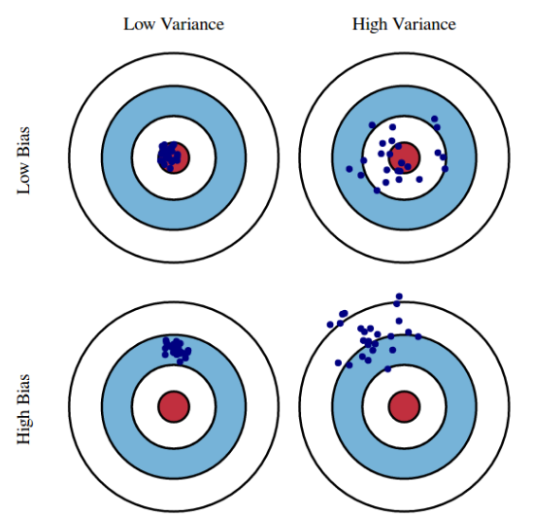
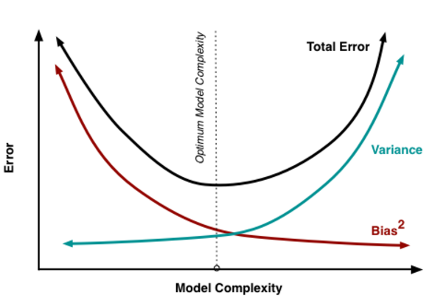
Bias-Variance Tradeoff
Bias: error caused by difference between expected estimator and true function
Variance: this is a measure of estimator spread... that is, how much does the estimator vary with a new data set

Slide 3
Feature Selection
Pick the best k features to use in linear regression
Why?
Predictive Accuracy: Multivariate Linear regression has low bias, high variance. Reduce the number of features, can get a bit more bias but much less variance (out of sample accuracy)
Interpretability: Which variables really matter? Which not? Interpretability allows the model to say something about the data (important in financial industry, may not be that important for Technology company), vs. just giving a prediction

Slide 4
Feature Selection
Selection based on t tests:
Select n features with the best t stats
Select all features with significant p-value
Selection based on R-squared:
Forward Stepwise
Backward Stepwise
Problems with the methods above: Can be unstable, only F-Stats or R^2 may not good enough to find the best model
Regularization – More Principled Way to Select Subsets
Lasso
Ridge

Slide 5
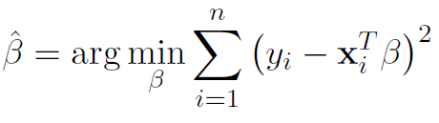
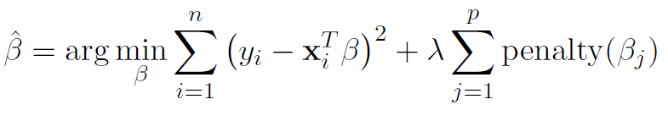
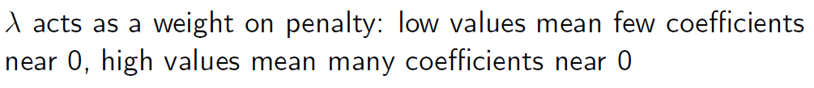
Regularization – Important Concept in DS
Regularization:
Place a penalty on large values for Betas
Add this penalty to the objective function
Solve the new Betas
OLS Objective Function:
New Objective Function:

Slide 6
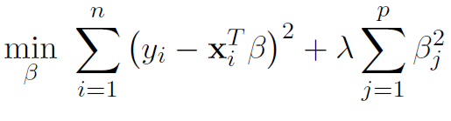
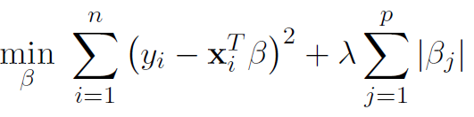
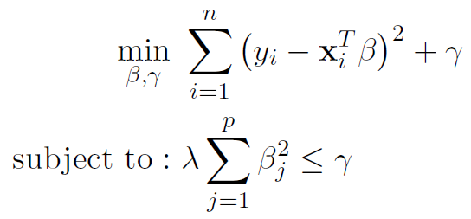
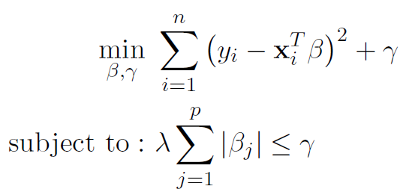
Lasso and Ridge Model
Ridge Regression (Squared Penalty)
Objective Function Equivalent to
Lasso Regression (Absolute Penalty)
Objective Function Equivalent to

Slide 7
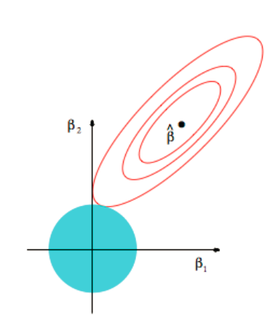
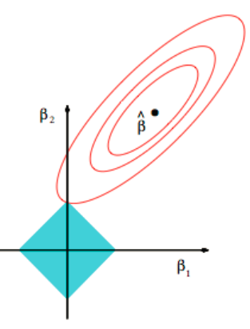
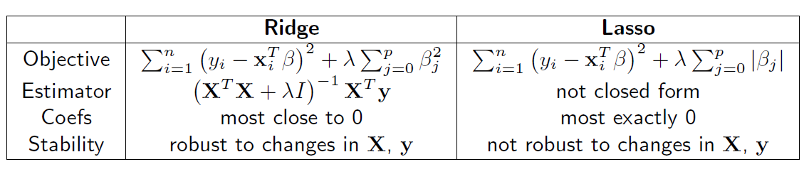
Lasso and Ridge Model
Ridge Regression (Squared Penalty)
Lasso Regression (Absolute Penalty)

